Slide 1


Programming in
Tools for dynamical systems
and climate
Reyk Börner
Python for Lunch Seminar, 18 September 2025

Slide 2
Two-language problem
Length
of code
Fortran, C, …
Python, Matlab
Execution time

Slide 3
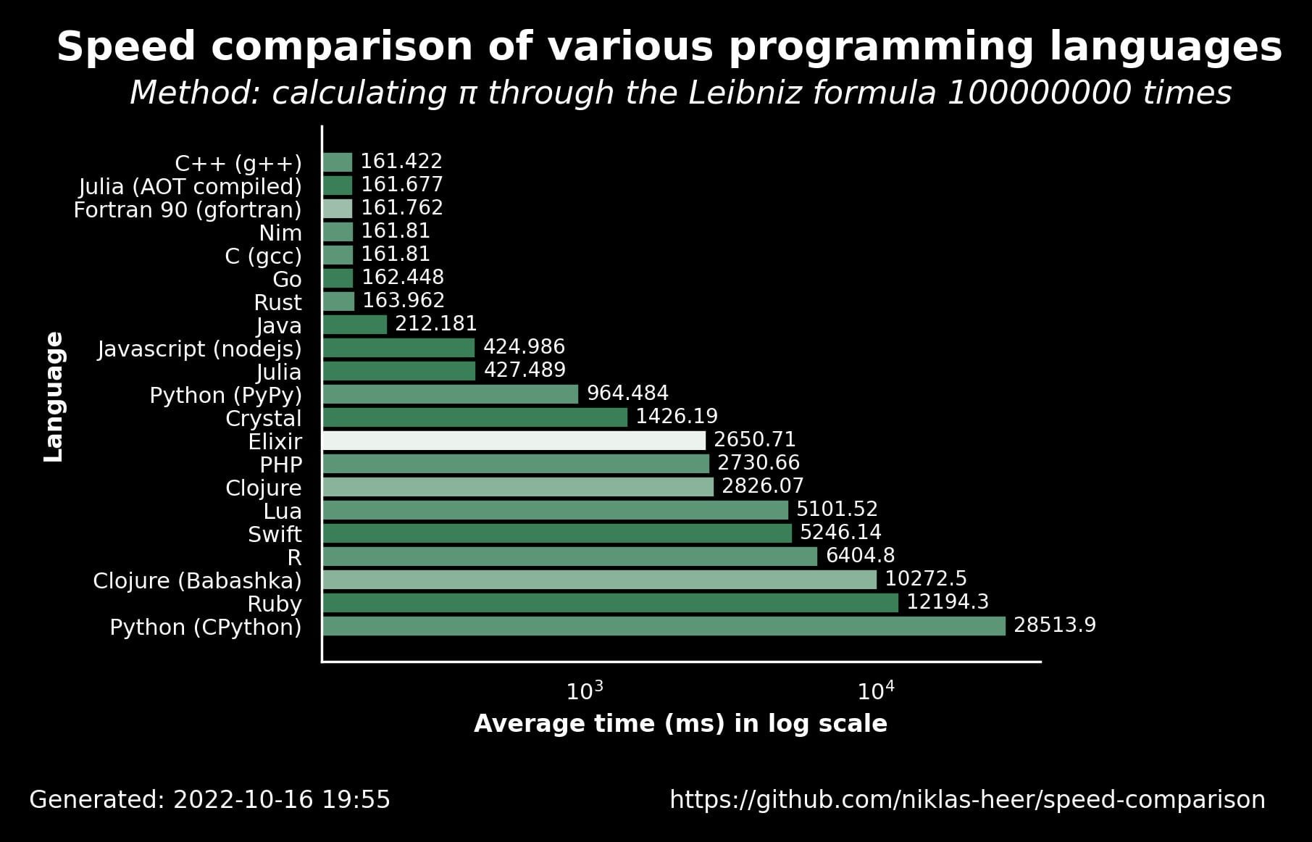
Two-language problem
Ahead of time compiled

Slide 4
Two-culture problem
Climate scientist
Software engineer
“A typical Julia user is already 90% of the way to a software developer”

Slide 5
What should a good scientific coding language offer?
Fast to write
Fast to run
Composable, clearly structured (easy to read)
Extendible
Accessible
Reproducible

Slide 6
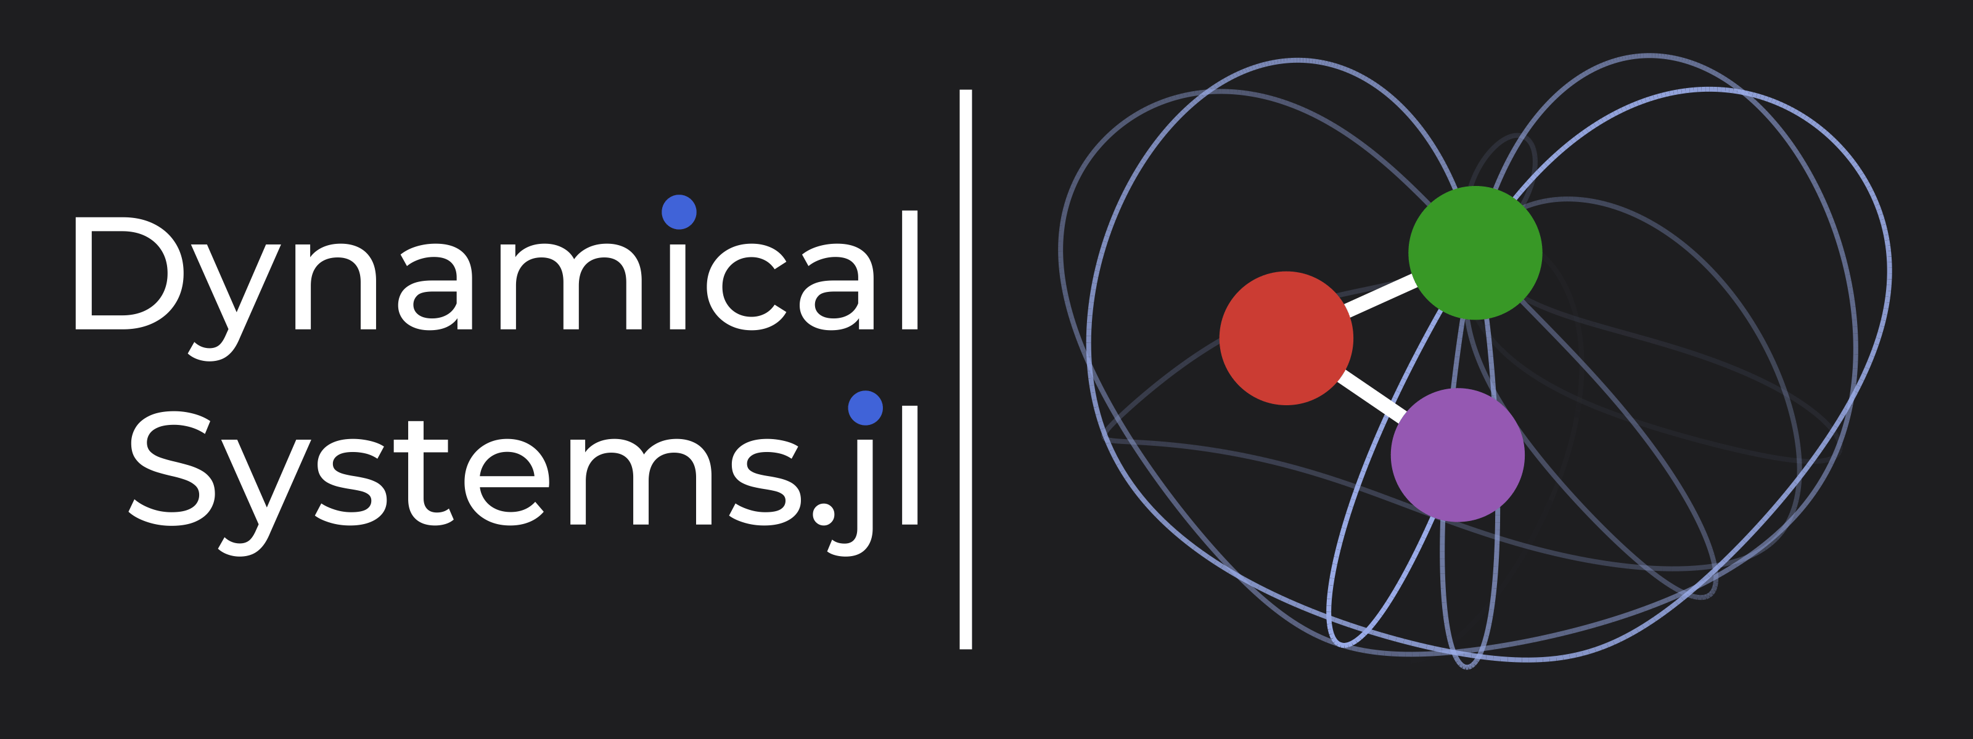
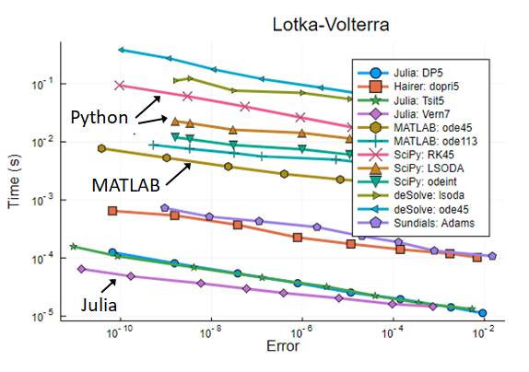

Julia for dynamical systems
SciML
DifferentialEquations.jl
JuliaDynamics
DynamicalSystems.jl
BifurcationKit.jl
CriticalTransitions.jl
Doug Frey

Slide 7



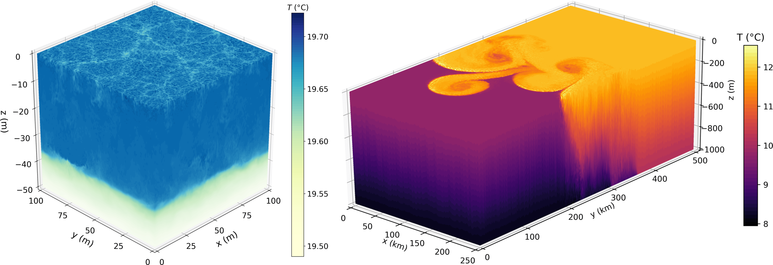
Julia for climate modeling
CliMA
ClimaOcean.jl
ClimaAtmos.jl
ClimaLand.jl
…
SpeedyWeather.jl
Oceananigans.jl

Slide 8
Writing your own Julia package
… see example: DoubleTrouble.jl

Slide 9
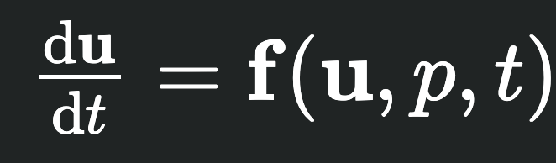

Contributing to DynamicalSystems.jl
CoupledODEs
CoupledSDEs

Slide 10
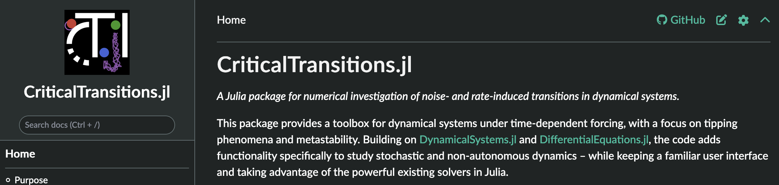
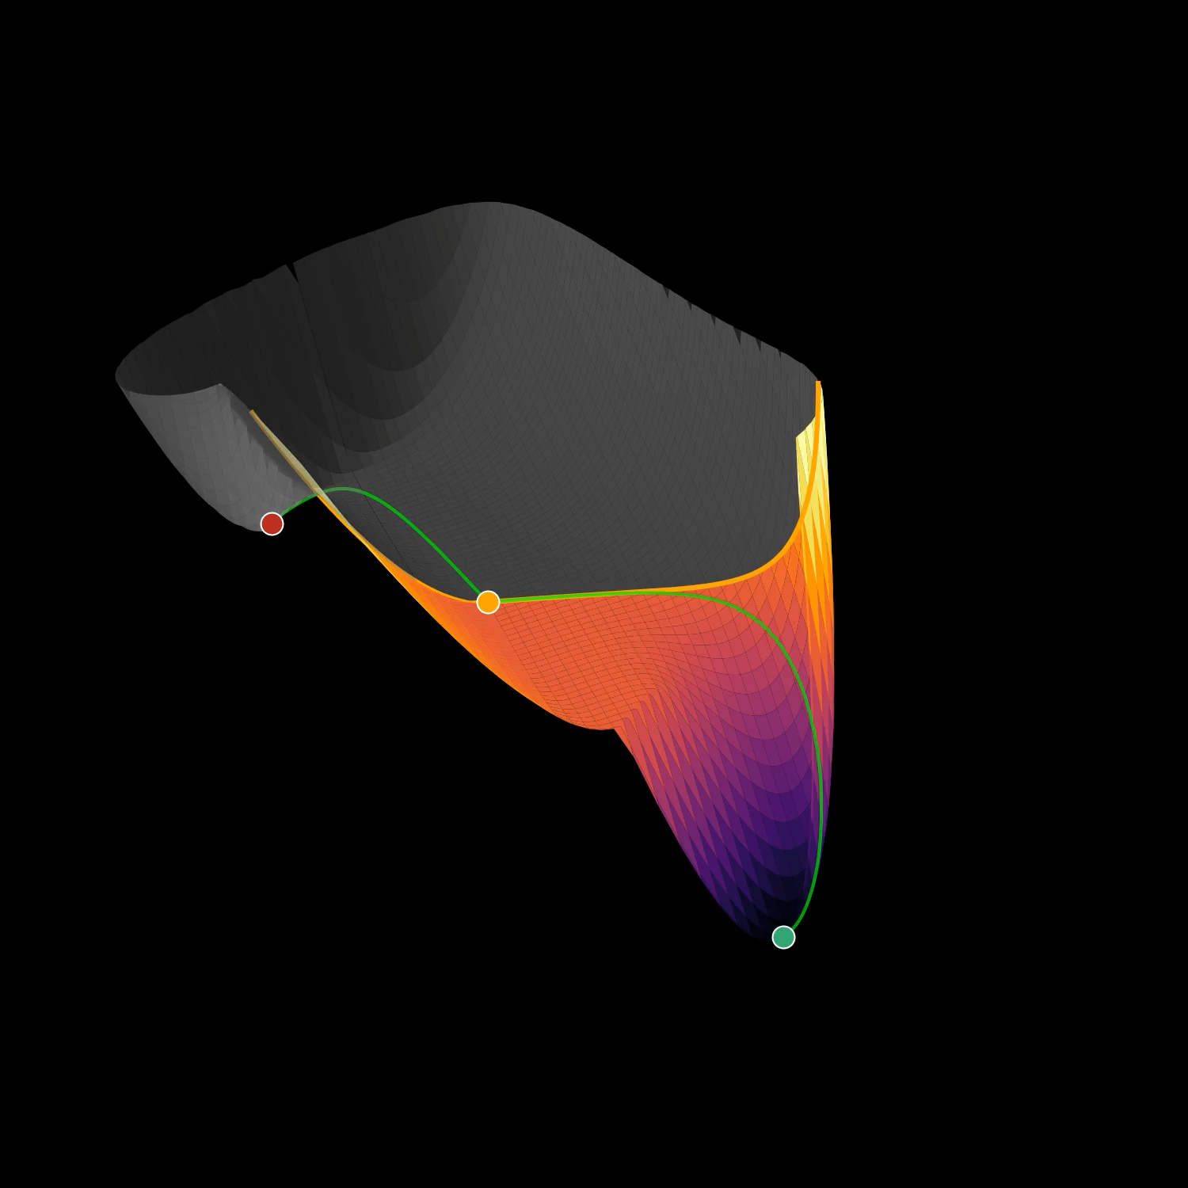
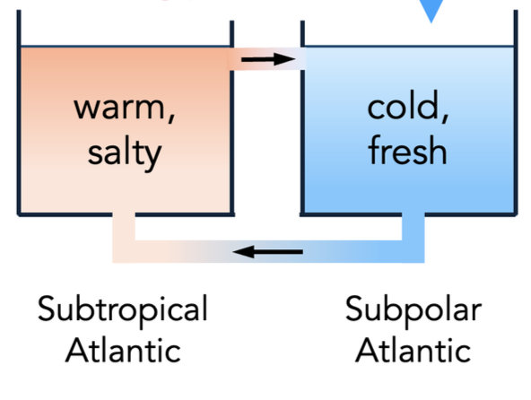
CriticalTransitions.jl
Freshwater flux
Example:
Stommel box model
(Stommel 1961)

Slide 11
Resources
Julia homepage: https://julialang.org
Juliaup (installer): https://github.com/JuliaLang/juliaup
Zero2Hero tutorial: https://github.com/Datseris/Zero2Hero-JuliaWorkshop
Good scientific code workshop: https://github.com/JuliaDynamics/GoodScientificCodeWorkshop
Thanks to
Orjan Ameye,
George Datseris,
Ryan Deeley,
Frank Hellmann,
Milan Klöwer,
Raphael Römer,
Paul Schultz

